Slide 1
Alfresco Administration And Customization
System Installation and Configuration

Slide 2
What is Alfresco ?
Alfresco is the leading open source alternative for Enterprise Content Management System.
Alfresco Helps in Document Management, Records management, Web Content Management,(WCM) and Collaboration (Alfresco Share) solutions.
It also allows contributions from the open source community to get higher-quality software produced more quickly, and at a much lower cost.

Slide 3
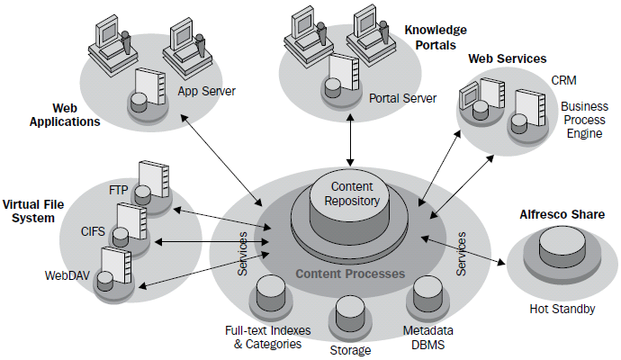
Alfresco Repository / Content Repository

Slide 4
Alfresco Repository / Content Repository
The Previous diagram provides an overview of the Alfresco content repository and its integration with external systems such as Virtual File Systems, Web Applications, Knowledge Portals, and Web Services.
The content repository provides these services to specialist content applications such as Document Management Systems, Web Content Management (WCM) systems, Image Management systems, Records Management, and other applications that require the storage and retrieval of large amounts of content.

Slide 5
Alfresco Architecture
Alfresco supports pluggable aspect-oriented architecture out of the box by leveraging open source standards and components such as Spring, Hibernate, Lucene, CMIS, JSR 168, JSR 170, and JSE6.
The architecture is based on open standards. Hence the applications built using Alfresco can be deployed on any environment, such as Windows, Linux, Mac, and so on.
It can use any relational database, such as MySQL, Oracle, DB2, Derby
It can use various application servers, such as JBoss Application Server, Apache Tomcat.

Slide 6
Alfresco Architecture
It can work with any browser, such as, Mozilla Firefox, Microsoft Internet Explorer.
Also, it can be integrated with any portal such as JBoss Portal, Liferay. Portal etc
Alfresco server can scale up information by using complex search, structure, and classification of information.

Slide 7
Alfresco is built upon open standards
Java 1.6
Java Content Repository API
Java Portlet Integration
Spring 2.0 Aspect-Oriented Framework
ACEGI Aspect-Oriented Security Framework
Hibernate 3.2 ORM Persistence
Lucene 2.1 Text Search Engine
AIFS (Alfresco Intelligent File System) supporting Windows Files sharing (SMB/CIFS), NFS, FTP

Slide 8
Alfresco is built upon open standards
WebDAV
Jakarta POI – Java API for accessing Microsoft file formats
PDFBox iText – Open source Java PDF libraries
Open Office 2.x
JSR-223 Java Language Integration—Scripting for Java platform
JBPM 3.2

Slide 9
Alfresco Features
Globalization support
Security and access control
Essential library services
Alfresco provides library services such as Check-in and Check-out, version control, auditing information, and content streaming.
Business process automation
Enterprise integration

Slide 10
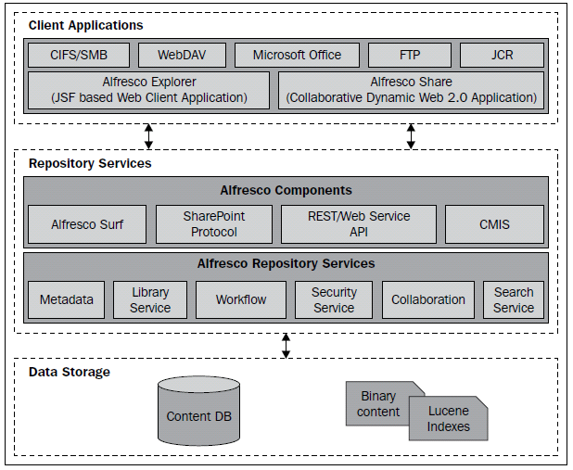
Alfresco Installation
Let us understand the alfresco installation architecture

Slide 11
Alfresco Installation Architecture Layers
Client Applications Layer
Repository Services Layer
Data Storage Layer

Slide 12
Components of Alfresco applications
The application server (Jboss, Tomcat) hosts the user interface and domain logic.
The application server houses Alfresco applications (such as the Alfresco Explorer and Alfresco Share) and the Alfresco repository.
The Alfresco repository provides a set of reusable cross-cutting content management services such as content storage, query, versioning, and transformation, which may be utilized by one or more applications.

Slide 13
Alfresco Explorer And Alfresco Share
Alfresco Explorer is the JSF based client, which is highly customizable and configurable according to specific user requirements.
The out of the box web client gives you lot of packaged functionality. With the web client management console, you can manage users, security, content, business rules.
Alfresco Share introduces a new, simplified, easy-to-use, and adopt knowledge worker UI.

Slide 14
Alfresco Administration And Customization
Introduction to Alfresco Webclient

Slide 15
Introduction to Alfresco Explorer / Webclient
The Alfresco Enterprise Content Management product is bundled and shipped along with two web-based applications. One is called the Alfresco Explorer, which was formerly known as the "Web Client".
The other web-based application is called Alfresco Share, which enables collaboration.

Slide 16
Use of Alfresco Explorer
Manage Users
Security
Content
Business Rules
Workflows

Slide 17
Log in to Alfresco as an Administrator
Url : http://localhost:8080/alfresco
Username : admin
Password : admin
Click submit which will show you the detail page of alfresco explorer.

Slide 18
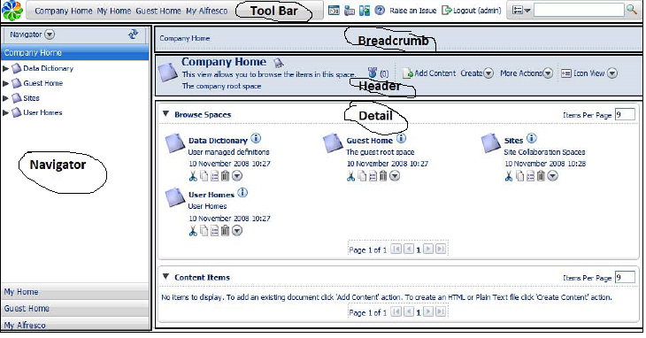

Screen Layout

Slide 19
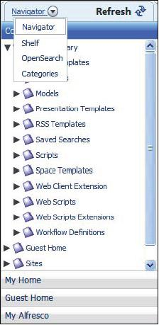
Navigator
The Navigator window is used to display the Navigator tree view. It consists of Shelf, OpenSearch, and Categories options, as shown in the following figure:

Slide 20
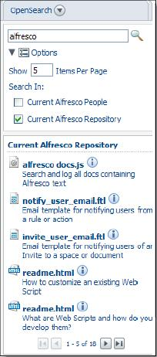
Open Search
The OpenSearch is Alfresco's implementation of an open standards based search API for sharing search results, and extending existing schemas such as ATOM and RSS.

Slide 21
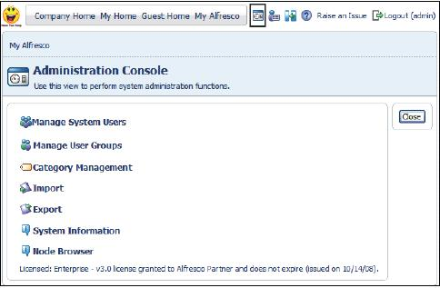
Administration Console
The Administration Console in the Alfresco Explorer is useful to perform all of the system administration tasks.

Slide 22
User and groups management
Alfresco provides Alfresco Explorer for managing alfresco System Users and Groups in efficient ways. Alfresco System users can be managed by a user who has sufficient permission like admin.
The Manage User Groups functionality is useful for creating groups of users and sub groups within the groups. Groups are useful for providing authorization to access the content.

Slide 23
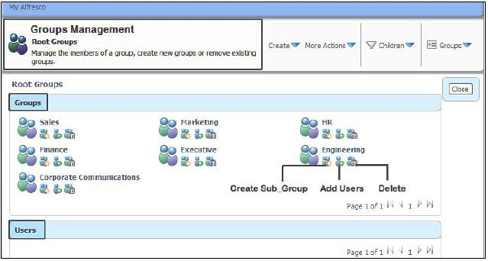
Create groups and subgroups
Following figure shows the groups description:

Slide 24
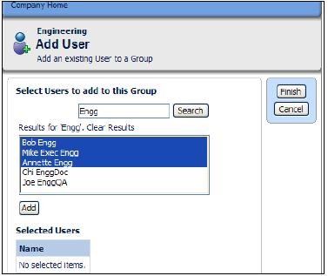
Add user from groups
Refer to figure:

Slide 25
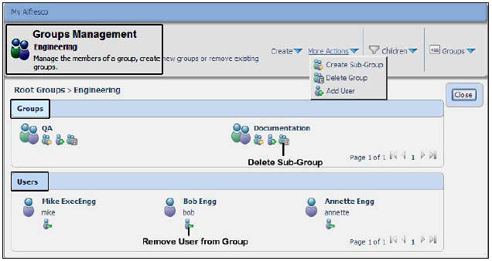
Remove user from groups
Refer to figure:

Slide 26
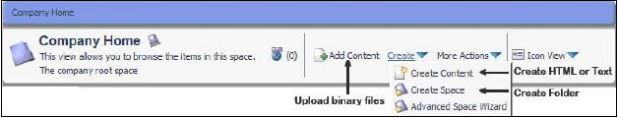
Create Space
Alfresco space is with additional properties such as business rules and security ,space can hold subspaces and any type of content. To create a space within a space, click on the Create icon in the header, and then click on the Create Space link as shown in the following screenshot:

Slide 27
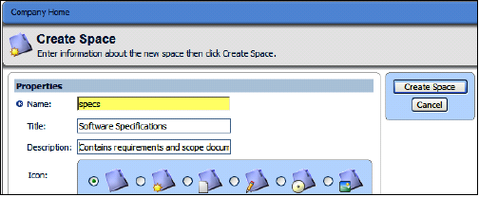
Create Space
The Create Space wizard will be displayed as shown in the following screenshot. Name is a mandatory property (as you can notice a small star next to the label), whereas Title and Description are the optional properties. You can also associate an icon with this space. Fill up the information and click on the Create Space button to create the space.

Slide 28
Create Content
In Alfresco, content is any kind of document such as a Microsoft Office file, Open Office file, PDF, HTML, XML, text, image, audio, or video file.
Each content item is made of two main elements
Content Itself
Metadata or Properties
To add a document to a space, click on the Add Content link in the header and provide the details
Click on the Create icon and click on the Create Content menu link

Slide 29
Create a link to content
A link is nothing but just a shortcut to a content located at different location.
Steps to create link as follows
1. Identify the target document and click on the Copy action (as shown in the previous screenshot).
2. The document will be placed on the clipboard.
3. Go to the space where you would like to create the link to the content.
4. Click on the Paste as Link icon in the clipboard to create the link, as shown in the next screenshot.

Slide 30
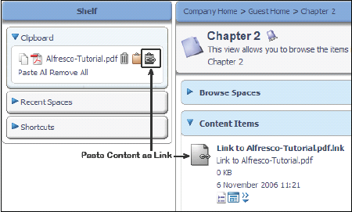
Create a link to content
Snap shot

Slide 31
Configuring personal dashboard using wizard
click on the My Alfresco link provided in the Tool Bar
click on the Configure icon, given in the My Alfresco Dashboard
The Configure Dashboard Wizard will open up.
Follow the steps provided in the wizard.

Slide 32
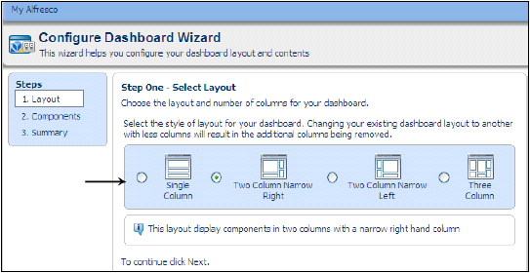
Configuring personal dashboard using wizard
Step one: Selection of layout

Slide 33
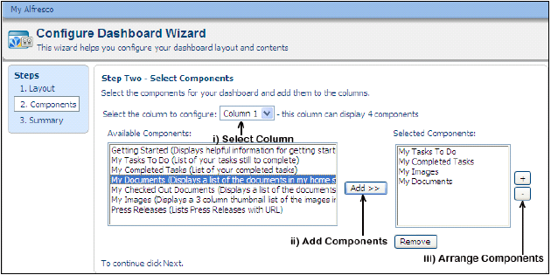
Configuring personal dashboard using wizard
Step two: Selecting components

Slide 34
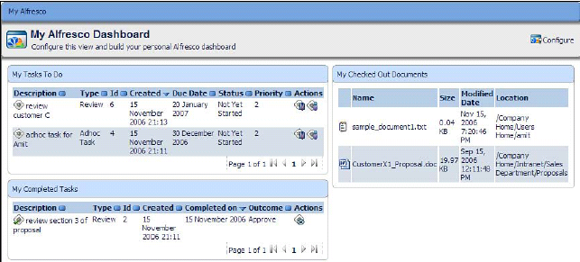
Configuring personal dashboard using wizard
Click on the Next or Finish button to save your selection

Slide 35
        Thank You.

